Slide 1

Unit 13

Slide 2
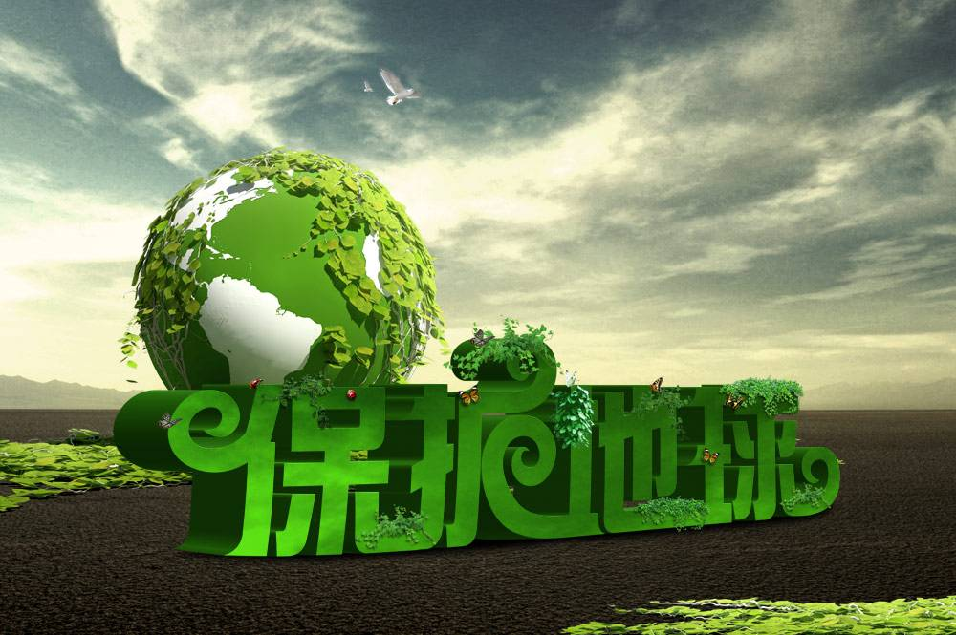
Unit 13
We’re trying to save the earth!

Slide 3



Slide 4


1. Learn to write a letter to the city mayor
about the environment problems in your
city and your suggestions.
2. To check yourself.

Slide 5


What should we do to save the earth?
Turn off the lights when we leave a room.
Take our own bags when shopping.
Ride a bike.
Recycle paper.
Don’t use paper napkins.

Slide 6
What should governments do to save the earth?
Close down the factories that put waste into the river.
Set up a lot of dustbins on the street.
Encourage people to reduce the use of
wooden chopsticks, plastic bowls and bags.
Organize people to clean up the streets and rivers.

Slide 7


3a
Think about the environment in your town/ city and complete the chart below.
Which parts of the town/ city have a nice environment? Why are they nice?
Which parts need to be improved? Why?

Slide 8
Good environment | Why | Bad environment | Why
The air is clean.
a lot of rubbish
park
river
so many trees
so many cars
streets
streets
clean and tidy
too many
factories
restaurants
air

Slide 9
Write a letter to the city mayor about the problems and your suggestions.
3b
In your letter, describe the environmental
problems in your town/city.
1. What are the problems?
2. Where are they?
3. What or who is causing these problems?
Then, give suggestions or possible ways to solve the problems.

Slide 10

I think that…
We should/ could…
I suggest…

Slide 11

写作指导
本次写作内容是一封建议信，信的主体部分为说明文, 时态采用一般现在时，人称用第一人称和第三人称。信中要介绍你所在城市存在有哪些环境问题，是谁造成的这些问题，然后提出解决这些环境问题的方法和措施。

Slide 12
列提纲 |  | 写句子
自我介绍及写信目的 |  | I’m from No. 5 Middle School. I like our city, but the environment around here is getting worse and worse.
环境问题1 | 问题 | There is white pollution everywhere in the city(这个城市到处都是白色污染).
 | 原因 | People use too many disposable (一次性的) things, such as plastic cups, bottles, bags and lunch boxes. People throw them away after only using them once (人们只用一次后就把它们扔掉了).
 | 建议 | I think that people should try to use their own cups, lunch boxes and chopsticks instead of disposable things (我认为人们应该尽量使用自己的杯子、饭盒和筷子来代替一次性用品).
环境问题2 | 问题 | There has been haze (雾霾) in the city in recent years.
 | 原因 | That’s because there are more and more cars on the road (那是因为马路上有越来越多的汽车) and they give off too much waste gas.

Slide 13
列提纲 |  | 写句子
环境问题2 | 建议 | People should use public transportation more (人们应该多使用公共交通工具). It’s a good idea to take buses and use shared bikes (乘公共汽车和使用共享单车是个好主意). I think the government should encourage more people to use new energy vehicles (新能源汽车).
表达希望 |  | I hope the environment in your city gets better and better.

Slide 14

Dear Mr. Mayor,
I’m from No. 5 Middle School. I like our city, but the environment around here is getting worse and worse.
First, there is white pollution everywhere in the city. People use too many disposable things, such as plastic cups, bottles, bags and lunch boxes. People throw them away after only using them once.

Slide 15
I think that people should try to use their own cups, lunch boxes and chopsticks instead of disposable things.
Second, there has been haze in the city in recent years. That’s because there are more and more cars on the road and they give off too much waste gas. People should use public transportation more. It’s a good idea to take buses and use shared bikes. I think the government should encourage more people to use new energy vehicles.
I hope the environment in your city gets better and better.
Yours sincerely,
Wang Lei

Slide 16


1. Write different forms of the words. Then
add more to each group.
v.— n.
pollute ---
act ---
protect---
inspire ---
build ---
create ---
pollution
action
protection
inspiration
building
creation
dance---
sing ---
travel---
drive ---
run ---
write ---
dancer
singer
traveler
driver
runner
writer

Slide 17
n. — adj.
fame ---
wood ---
science---
health ---
south ---
care ---
famous
wooden
scientific
healthy
southern
careful
rain ---
cloud---
luck ---
help ---
color ---
day ---
rainy
cloudy
lucky
helpful
colorful
daily

Slide 18
adj.— n.
different ---
important---
sunny ---
noisy ---
harmful ---
beautiful ---
woolen---
difference
importance
sun
noise
harm
beauty
wool

Slide 19
adj. — adv.
slow ---
wide ---
sudden ---
real ---
quick ---
true ---
possible---
slowly
widely
suddenly
really
quickly
truly
possibly
happy ---
loud ---
quiet ---
heavy ---
easy ---
angry ---
good ---
happily
loudly
quietly
heavily
easily
angrily
well

Slide 20
2. Match each statement with the grammar
structure.
Statement | Grammar
The river used to be so clean. | Present progressive
We have seen many changes in the environment. | Modal verbs
People should take public transportation more. | Passive voice
The river is polluted by factories. | used to
The air pollution is getting worse and worse. | Present perfect

Slide 21
3. Write ways to cut down on these kinds
of pollution.
Kinds of pollution | Ways to cut down
water pollution
land pollution
noise pollution
air pollution
Stop factories from throwing waste into rivers.
Try not to use plastic bags when shopping.
Build airports away from places where people live.
Reduce the number of factories that burn coal.

Slide 22


Ⅰ. 根据语境及所给汉语提示，完成下列句子或
对话，每空一词。
1. Sara would like a house with a garden
_________ _________ _________ (在……前面)
it.
2. —Look, the little boy is holding the book
_________ _________ (上下颠倒).
—He is too young to read books.
in front of
upside down

Slide 23
3. The school once encouraged the students to
_________ _________ _________ (回收利用旧
书).
4. After many years of hard work, his dream to
_________ _________ (经营) his own business
came true.
5. Mr. Smith is going to give us a talk on
____________ _________ (环境保护) tonight.
recycle old books
set up
environmental protection

Slide 24
Ⅱ. 根据短文内容及所给首字母提示，补全文
中所缺单词，使短文完整、通顺。
Old Henry is Jessica’s grandfather. People like him because this old man is friendly to them. What does this old man do? Oh, he used to catch fish, so he was a f (1). Now he doesn’t catch fish anymore because he’s really old. But this old man doesn’t stay at home to relax. He has started another job. He collects l (2) everywhere in his village, including rubbish at the b (3) of the river.
fisherman
litter
bottom

Slide 25
Some people asked Old Henry, “Why do you collect rubbish?” He said, “You know, rubbish is h (4) to our environment. I collect it and some of it can be r (5). Why shouldn’t I do it?”
harmful
recycled

Slide 26


Finish the letter to the city mayor about the enviromental problems in your city and your suggestions.

Slide 27


